Slide 1
Derivatives.
Important concept.
Simple to grasp in Kotlin.
Breandan Considine
@breandan

Slide 2
What are derivatives?
How do derivatives work?
What can be derived?
How do I derive in Kotlin?
What’s the difference?

Slide 3
What are derivatives?

Slide 4
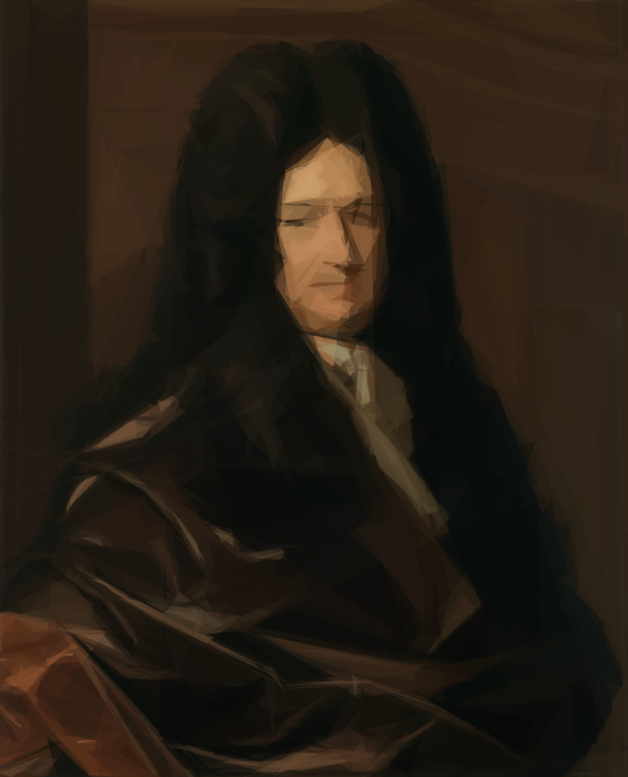
What are derivatives?
https://en.wikipedia.org/wiki/Gottfried_Wilhelm_Leibniz

Slide 5
Why not just try and fail?

Slide 6
How do derivatives work?

Slide 7
Sum rule
Notes:
\frac{d}{dx}(l \cdot r) = \frac{dl}{dx}\cdot r + l \cdot \frac{dr}{dx}

Slide 8
Product rule
Notes:
\frac{d}{dx}(l \cdot r) = \frac{dl}{dx}\cdot r + l \cdot \frac{dr}{dx}

Slide 9
Chain rule
Notes:
\frac{d}{dx}(l \circ r) = \frac{dl}{dr} \cdot \frac{dr}{dx}

Slide 10
class D<X : Fun<X>>(val func: Fun<X>) : Fun<X>(f) { fun Fun<X>.df(): Fun<X> = when (this) { is Sum -> left.df() + right.df() is Prod -> left.df() * right + left * right.df()
is Comp -> func.df()(arg) * arg.df() } }

Slide 11
class D<X : Fun<X>>(val func: Fun<X>) : Fun<X>(f) { fun Fun<X>.df(): Fun<X> = when (this) { is Sum -> left.df() + right.df() is Prod -> left.df() * right + left * right.df()
is Comp -> left.df()(right) * right.df()
is D -> func.df() } }

Slide 12

How do derivatives work?

Slide 13
What can be differentiated?

Slide 14
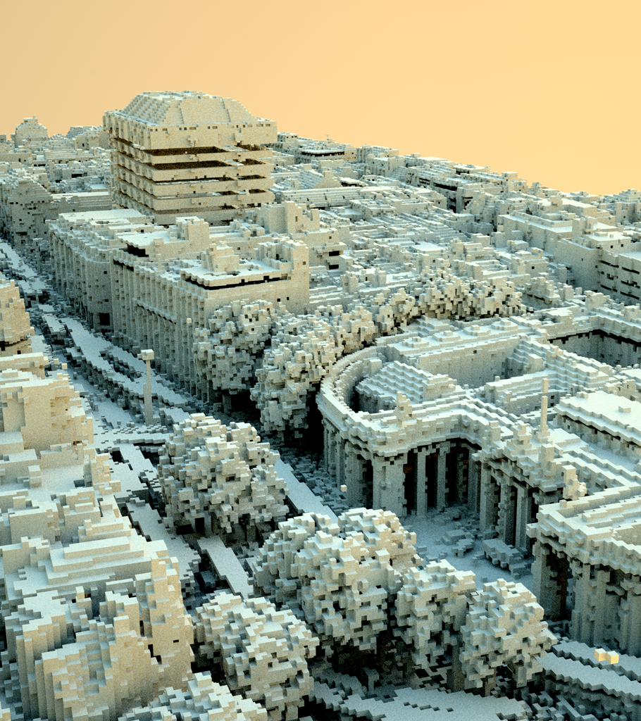

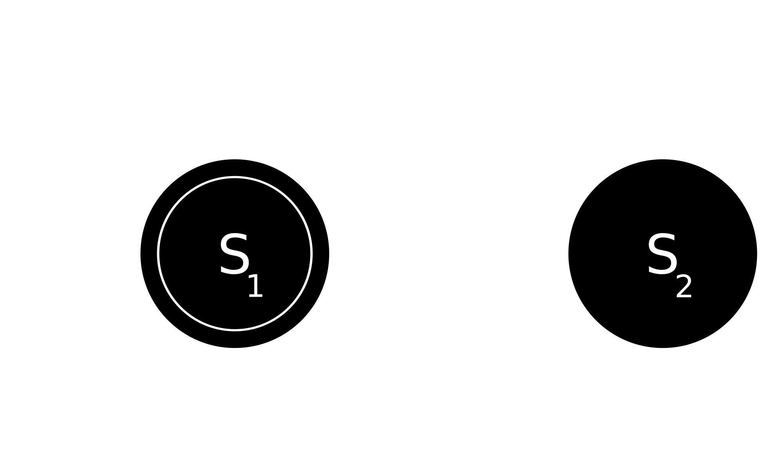
Computer science
The world is discrete
Point Cloud Voxelization
(Tommy Hinks)

Slide 15


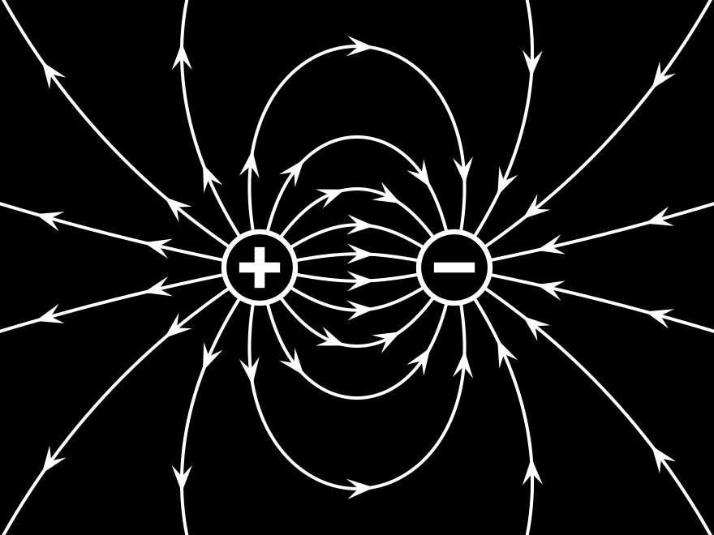
Physicists
World is differentiable

Slide 16
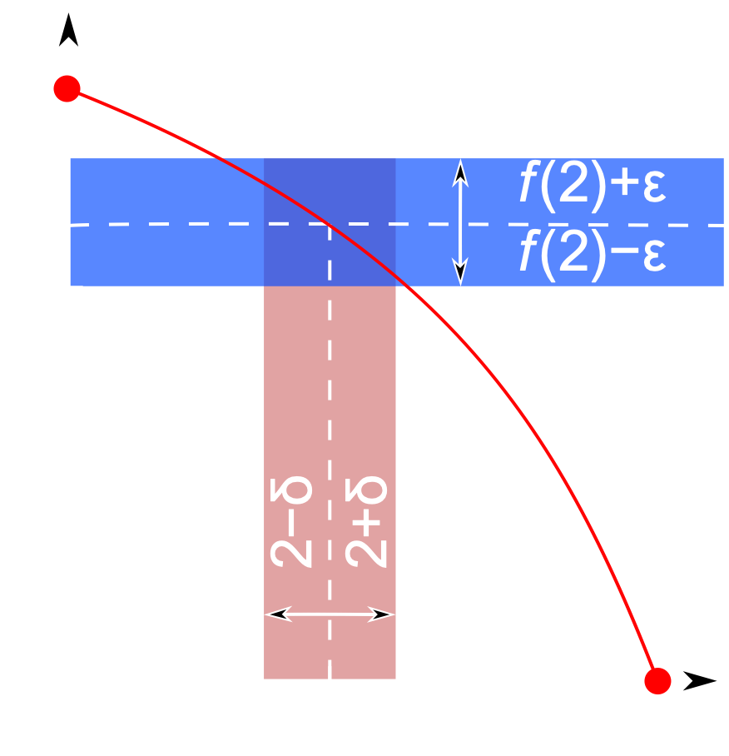
Continuity

Slide 17
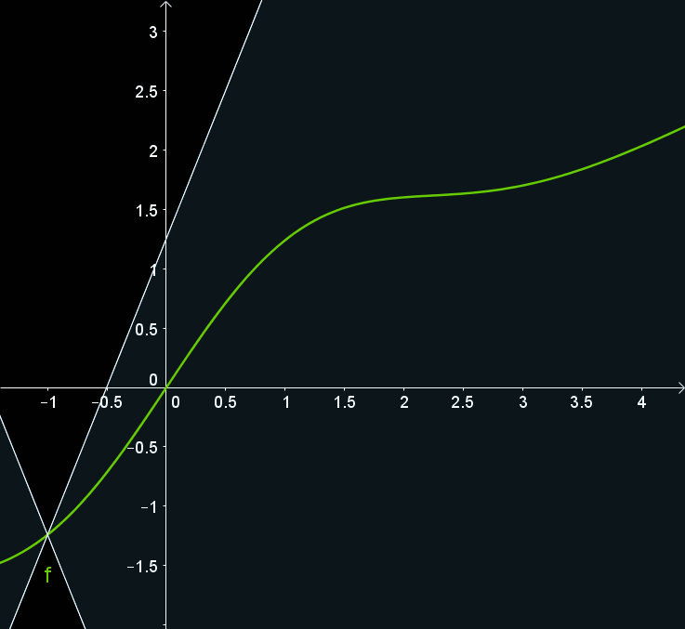
Continuity

Slide 18
How do I derive in Kotlin?

Slide 19
interface Group<X : Group<X>> { operator fun unaryMinus(): X operator fun plus(addend: X): X operator fun minus(subtrahend: X): X = this + -subtrahend } interface Field<X : Field<X>> : Group<X> { operator fun div(divisor: X): X operator fun times(multiplicand: X): X infix fun pow(exp: X): X fun ln(): X }

Slide 20
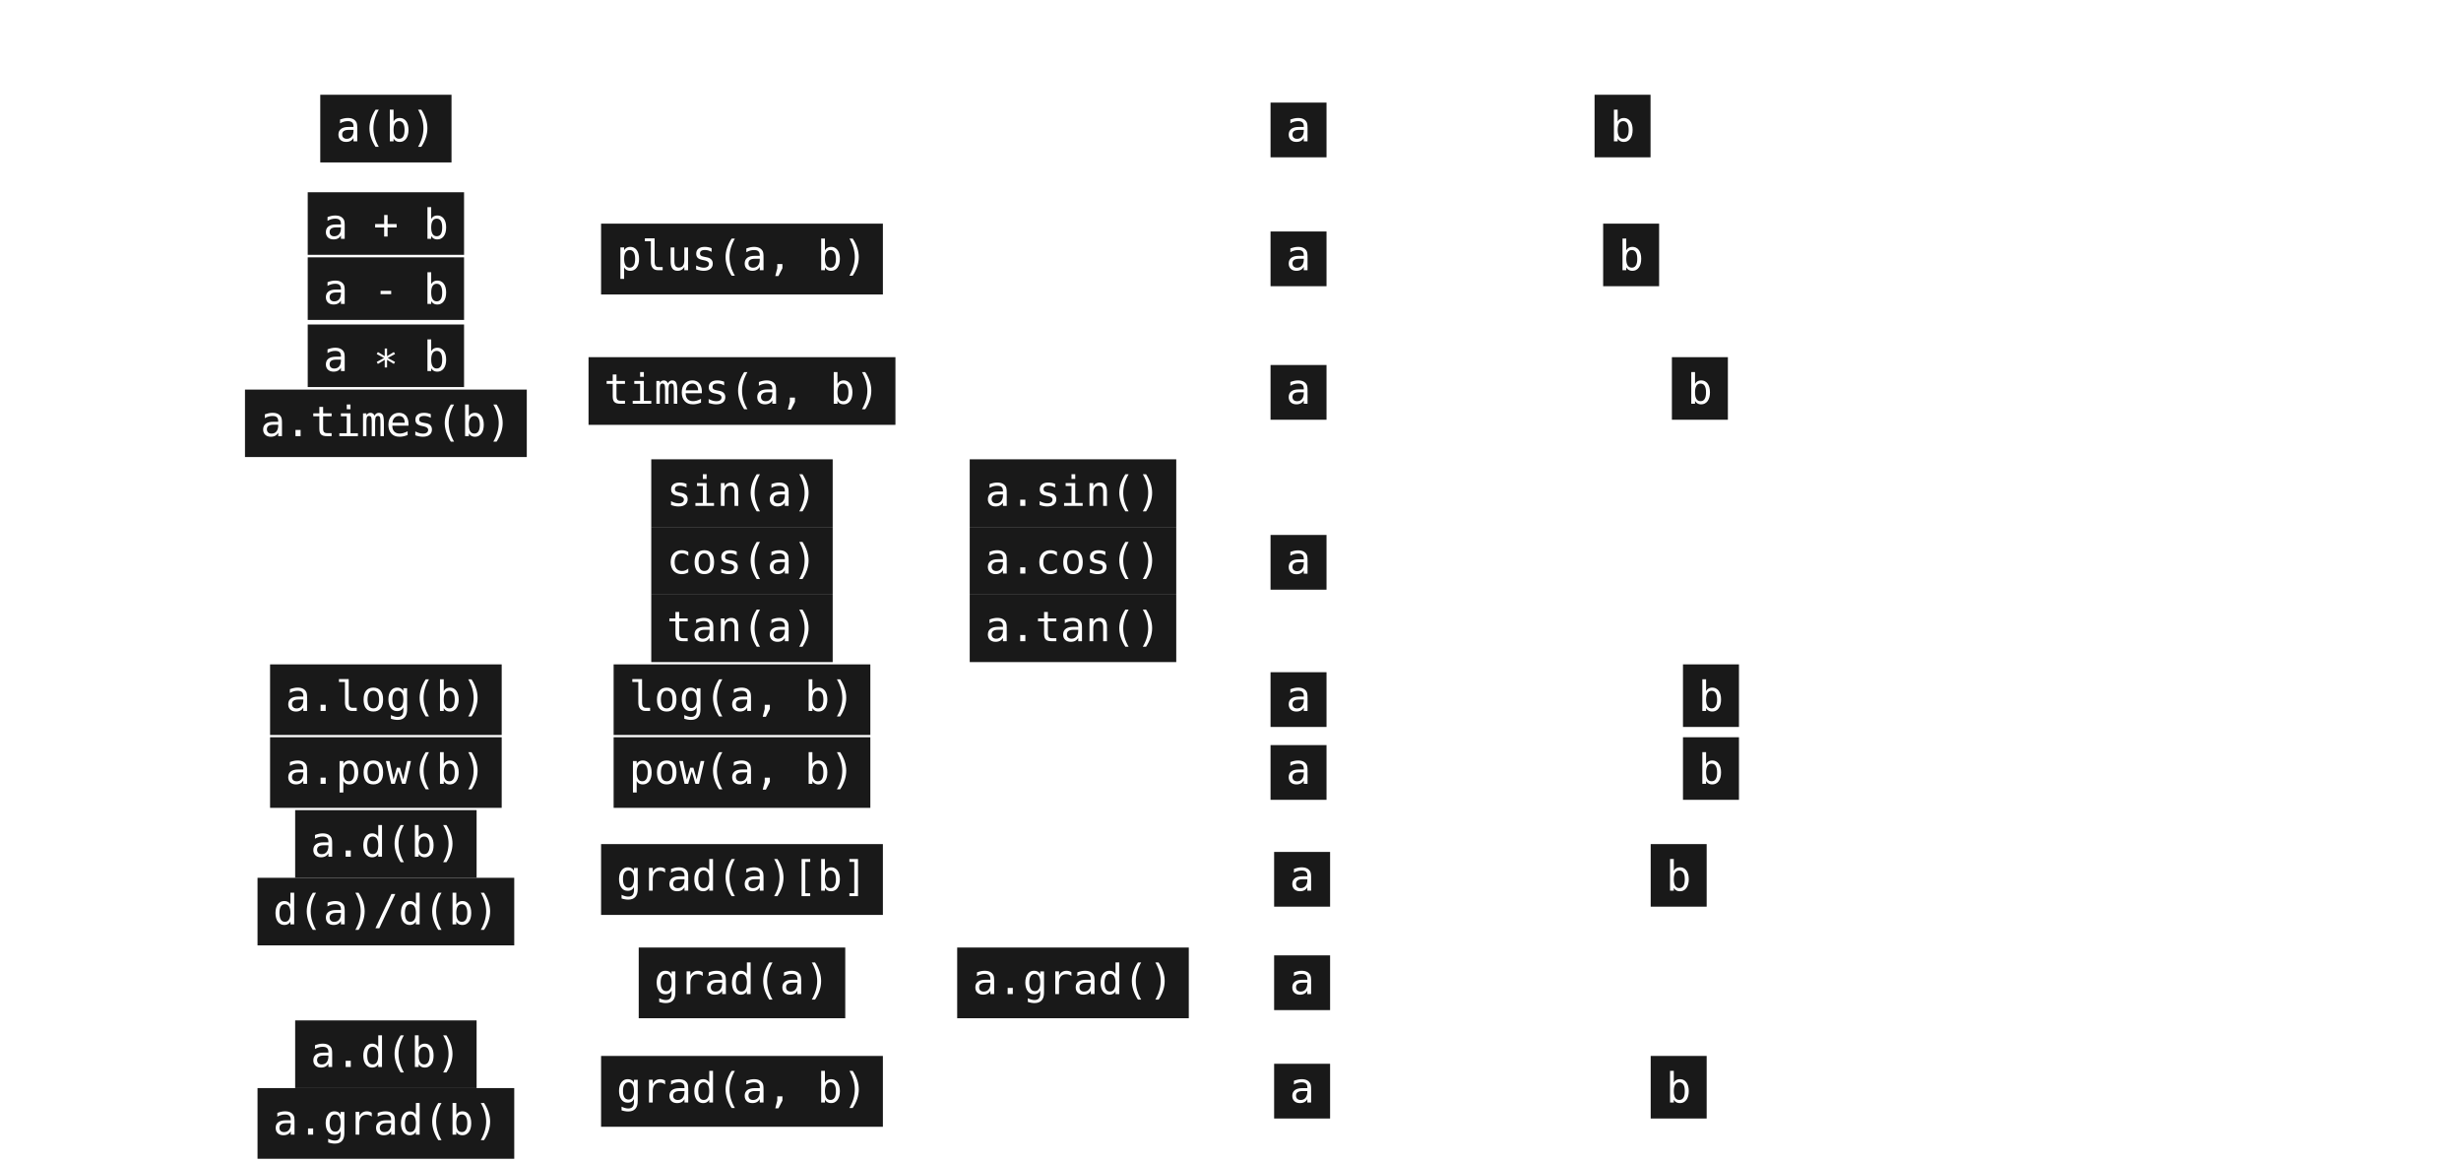
Compile-time shape safety
Notes:
\begin{tabular}{|c|c|c|c|l|}
\hline
\multicolumn{1}{|c|}{Math} & Infix & Prefix & Postfix & Operator Type Signature \\ \hline
\begin{tabular}{@{}c@{}}$\mathbf{\mathbf{A}}(\mathbf{\mathbf{B}})$\\$\mathbf{\mathbf{A}}\circ\mathbf{\mathbf{B}}$\end{tabular} & \tinline{a(b)} & & & $ ($\tinline{a}$: \mathbb{R}^{\tau}\rightarrow\mathbb{R}^{\pi}$, $\tinline{b}: \mathbb{R}^{\lambda} \rightarrow \mathbb{R}^{\tau}) \rightarrow (\mathbb{R}^{\lambda}\rightarrow \mathbb{R}^{\pi}) $ \\ \hline
$\mathbf{\mathbf{A}}\pm\mathbf{\mathbf{B}}$ & \begin{tabular}{@{}c@{}}\tinline{a + b}\\\tinline{a - b}\end{tabular} & \tinline{plus(a, b)} & & $ ($\tinline{a}$: \mathbb{R}^{\tau}\rightarrow\mathbb{R}^{\pi},~$\tinline{b}$: \mathbb{R}^{\lambda} \rightarrow \mathbb{R}^{\pi}) \rightarrow (\mathbb{R}^{?}\rightarrow \mathbb{R}^{\pi}) $ \\ \hline
$\mathbf{A} \mathbf{B}$ & \begin{tabular}{@{}c@{}}\tinline{a * b}\\\tinline{a.times(b)}\end{tabular} & \tinline{times(a, b)} & & $ ($\tinline{a}$: \mathbb{R}^{\tau}\rightarrow\mathbb{R}^{m \times n},~$\tinline{b}$: \mathbb{R}^{\lambda}\rightarrow\mathbb{R}^{n \times p}) \rightarrow (\mathbb{R}^{?}\rightarrow\mathbb{R}^{m \times p}) $ \\ \hline
% \begin{tabular}{@{}c@{}}$\frac{\mathbf{A}}{\mathbf{B}}$\\$\mathbf{A}\mathbf{B}^{-1}$\end{tabular} & \begin{tabular}{@{}c@{}}\tinline{a / b}\\\tinline{a.div(b)}\end{tabular} & \tinline{div(a, b)} & & $ ($\tinline{a}$: \mathbb{R}^{\tau}\rightarrow\mathbb{R}^{m \times n},~$\tinline{b}$: \mathbb{R}^{\lambda}\rightarrow\mathbb{R}^{p \times n}) \rightarrow (\mathbb{R}^{?}\rightarrow\mathbb{R}^{m \times p}) $ \\ \hline
% $\pm\mathbf{\mathbf{A}}$ & & \begin{tabular}{@{}c@{}}\tinline{-a}\\\tinline{+a}\end{tabular} & \begin{tabular}{@{}c@{}}\tinline{a.unaryMinus()}\\\tinline{a.unaryPlus()}\end{tabular} & $ ($\tinline{a}$: \mathbb{R}^{\tau}\rightarrow\mathbb{R}^{\pi}) \rightarrow (\mathbb{R}^{\tau}\rightarrow\mathbb{R}^{\pi}) $ \\ \hline
\begin{tabular}{@{}c@{}}sin(a)\\cos(a)\\tan(a)\end{tabular} & & \begin{tabular}{@{}c@{}}\tinline{sin(a)}\\\tinline{cos(a)}\\\tinline{tan(a)}\end{tabular} & \begin{tabular}{@{}c@{}}\tinline{a.sin()}\\\tinline{a.cos()}\\\tinline{a.tan()}\end{tabular} & $ ($\tinline{a}$: \mathbb{R}\rightarrow\mathbb{R}) \rightarrow (\mathbb{R}\rightarrow\mathbb{R}) $ \\ \hline
% $\ln(\mathbf{A})$ & & \begin{tabular}{@{}c@{}}\tinline{ln(a)}\\\tinline{log(a)}\end{tabular} & \begin{tabular}{@{}c@{}}\tinline{a.ln()}\\\tinline{a.log()}\end{tabular} & $ ($\tinline{a}$: \mathbb{R}^{\tau}\rightarrow\mathbb{R}^{m \times m}) \rightarrow (\mathbb{R}^{\tau}\rightarrow\mathbb{R}^{m \times m}) $ \\ \hline
$\log_b \mathbf{A}$ & \tinline{a.log(b)} & \tinline{log(a, b)} & & $ ($\tinline{a}$: \mathbb{R}^{\tau}\rightarrow\mathbb{R}^{m \times m},~$\tinline{b}$: \mathbb{R}^{\lambda}\rightarrow\mathbb{R}^{m \times m}) \rightarrow (\mathbb{R}^{?}\rightarrow\mathbb{R}) $ \\ \hline
$\mathbf{A}^{b}$ & \tinline{a.pow(b)} & \tinline{pow(a, b)} & & $ ($\tinline{a}$: \mathbb{R}^{\tau}\rightarrow\mathbb{R}^{m \times m},~$\tinline{b}$: \mathbb{R}^{\lambda}\rightarrow\mathbb{R}) \rightarrow (\mathbb{R}^{?}\rightarrow\mathbb{R}^{m \times m}) $ \\ \hline
% \begin{tabular}{@{}c@{}}$\sqrt{a}$\\$\sqrt[3]{a}$\end{tabular} & \begin{tabular}{@{}c@{}}\tinline{a.pow(1.0/2)}\\\tinline{a.root(3)}\end{tabular} & \begin{tabular}{@{}c@{}}\tinline{a.pow(1.0/2)}\\\tinline{a.root(3)}\end{tabular} & \begin{tabular}{@{}c@{}}\tinline{a.sqrt()}\\\tinline{a.cbrt()}\end{tabular} & $ ($\tinline{a}$: \mathbb{R}^{\tau}\rightarrow\mathbb{R}^{m \times m}) \rightarrow (\mathbb{R}\rightarrow\mathbb{R}^{m \times m}) $ \\ \hline
\begin{tabular}{@{}c@{}}$\frac{da}{db}$, $\frac{\partial{a}}{\partial{b}}$\\$D_{b}a$\end{tabular} & \begin{tabular}{@{}c@{}}\tinline{a.d(b)}\\\tinline{d(a)/d(b)}\end{tabular} & \tinline{grad(a)[b]} & & $ \big($\tinline{a}$: C(\mathbb{R}^{\tau}\rightarrow\mathbb{R})$, $\tinline{b}: C(\mathbb{R}^{\lambda}\rightarrow\mathbb{R})\big) \rightarrow (\mathbb{R}^{?}\rightarrow\mathbb{R}) $ \\ \hline
$\nabla a$ & & \tinline{grad(a)} & \tinline{a.grad()} & $ \big($\tinline{a}$: C(\mathbb{R}^{\tau}\rightarrow\mathbb{R})\big) \rightarrow (\mathbb{R}^{\tau}\rightarrow\mathbb{R}^{\tau}) $ \\ \hline
$\nabla_{\mathbf{B}} a$ & \begin{tabular}{@{}c@{}}\tinline{a.d(b)}\\\tinline{a.grad(b)}\end{tabular} & \tinline{grad(a, b)} & & $ \big($\tinline{a}$: C(\mathbb{R}^{\tau}\rightarrow\mathbb{R})$, $\tinline{b}: C(\mathbb{R}^{\lambda}\rightarrow\mathbb{R}^{n})\big) \rightarrow (\mathbb{R}^{?}\rightarrow\mathbb{R}^{n}) $ \\ \hline
\end{tabular}

Slide 21
What’s the difference?

Slide 22
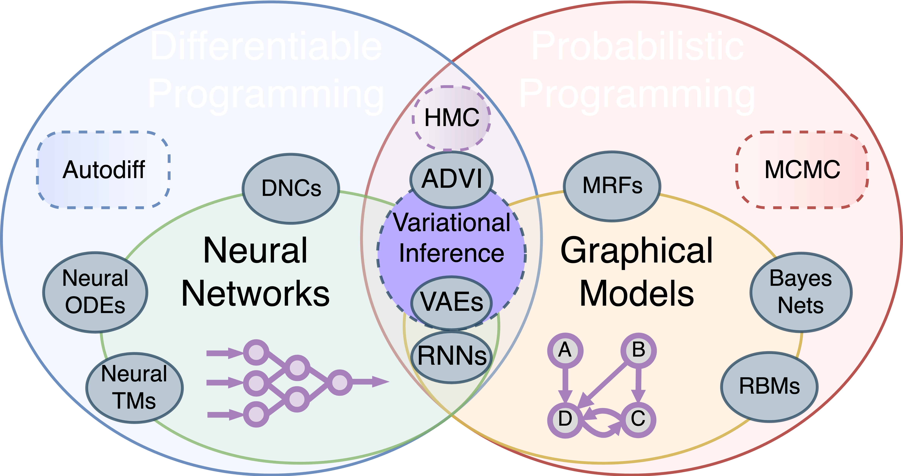
Why do derivatives matter?

Slide 23
@breandan

